Slide 1
Semantic Enrichment of Pretrained Embedding Output for Unsupervised IR
Edmund Dervakosa,c, Giorgos Filandrianosa,c, Konstantinos Thomasa,c,
Alexios Mandaliosa,c, Chrysoula Zervaa,b and Giorgos Stamoua
Team Members:
Gajender Sharma - 21111028
Kajal Sethi - 21111033
Pranshu Sahijwani - 21111048
Utkarsh Srivastava - 21111063

Slide 2
Problem statement/need for the project
With new discoveries and findings, supervised algorithms becomes less relevant due to lack of data.
Covid-19 showed us that we need to further explore the areas not currently explored in scientific literature therefore the need for unsupervised algorithms.
Notes:
The rapid emergence of new topics and findings often hinders the performance of supervised approaches, due to the lack of relevant data. For example, during covid, the disease was so new that data couldnt be found for training the supervised models. With time the supervised models kept improving their accuracy as the data increased, but the change in trend was very rapid thus hindering the exploitation of the models’ learnings.

Slide 3
Introduction
The paper investigates the potential of semantically enhancing deep transformer architectures using SNOMED-CT in order to answer user queries in an unsupervised manner.
The system filters and re-rank documents related to a query that were initially retrieved using BERT models. The BERT models are used as baseline models.
Using SNOMED-CT to semantically improve(re-rank) the rankings of pre-existing BERT algorithm.
The documents are then re-rank using SNOMED-CT to define a new concept co-occurrence based metric.
Notes:
SNOMED-CT is the most comprehensive clinical healthcare terminology, consisting of more than 350,000 concepts, covering clinical findings, symptoms, diagnoses, etc.

Slide 4
Dataset
Key feature of the paper is, it’s domain specific data in biomedical and clinical domain
The dataset used is the OHSUMED dataset and kaggle's CORD-19 full-text dataset was also adapted.
The OHSUMED test collection is a subset of the MEDLINE database.
It consisted of 50,216 docs published in the year 1991, out of which the first 20,000 documents are used.
For this dataset, the TREC-09 IR task contained a total of 108 queries, each query associated with a set of relevant documents out of which 56 queries are used for evaluation.
Notes:
first 20,000 documents are selected because it is a commonly used subset in scientific literature.
Text REtrieval Conference (TREC) is an ongoing series of workshops focusing on a list of different information retrieval (IR) research areas, or tracks.

Slide 5
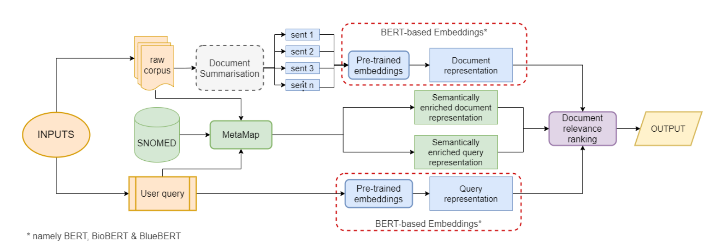
Summary of system architecture
Notes:
The diagrams here shows that the input contains two parts i.e. the raw dataset and user query. Firstly the raw dataset is summarized i.e. for every document only to relevant sentences are selected to represented it. This summarization is then converted into vectors using the pretrained embeddings. Same is done for the query. Also both of these are combined with the SNOMED-CT concepts with help of metamap(maps rich SNOMED-CT concepts to raw text) thus giving a ranked list according to the SNOMED dataset. Using both these the most relevant docs are retrieved. This will be further explained in next section.

Slide 6
Methodology
Overall System Architecture
Document Formatting: Summarisation of full-text documents to obtain a representative set of sentences.
Semantic text enrichment (SNOMED-CT): Aligning concepts in documents with their description in the knowledge base.
Vectorized text representations: Using vector representation to compare documents and queries.

Slide 7
2. Document Formatting
There are two main categories of papers:-
Abstract-Only: The paper for which only title and abstract is available due to licensing are represented using vector representation of the concatenation of title and abstract
Full text documents: For the papers with invalid abstract(<3 lines), full text summarization leads to inconsistent results due to length discrepancy. To conquer this, extractive text summarization is used.

Slide 8
2.1 Extractive Text Summarisation
The most representative sentences from the papers were selected instead of focussing only on the abstract, so that one IR model could run on all paper documents available
The method was applied to the CORD-19 dataset only, as OHSUMED consists exclusively of abstracts
The training dataset was constructed considering that the abstract contains the most important information of the paper (inductive bias)
We thus score the 𝑏𝑜𝑑𝑦 sentences against the 𝑎𝑏𝑠𝑡𝑟𝑎𝑐𝑡 sentences using ROUGE-L score to obtain the 𝑛 sentences.

Slide 9
3. Vectorized embedding representations for IR
For retrieving docs, the BERT representation was calculated for the user query and each candidate document
Ranked the docs according to the relevance by calculating cosine distance between the vector representations
In this process BERT embeddings were used trained on Wikipedia and BookCorpus for generic domain,
BioBERT trained on Pubmed papers,
BlueBERT, trained in a multi-task setting on a combination of biomedical and clinical data.

Slide 10
4. Semantic Based Filtering: SNOMED-CT
The main attraction to use it was that it implements the concept of hierarchy(useful in the case of searching in a corpus of texts with multi-level information) and descriptions(containing synonyms)
One of the challenges in terms of transferring these rich SNOMED-CT concepts to raw text, is to be able to identify the relevant terms in text.
For this purpose, we employ the MetaMap tool, which maps biomedical text to the UMLS metathesaurus.
Then we use a mapping between UMLS and SNOMED concepts in order to incorporate the SNOMED knowledge

Slide 11

4.1 Filtering
After getting
the list of documents using cosine similarity,
The set of text spans in those docs are identified that corresponding to SNOMED concepts and
The results of queries fired on SNOMED concepts using its hierarchy,
Two things are identified from SNOMED-CT:
Parent concept
Description of concepts
Finally we take intersection of the above two and calculate the concept filter . If the value of concept filter falls below a certain threshold, we simply keep it as 1.

Slide 12
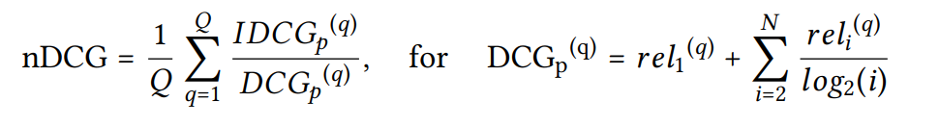
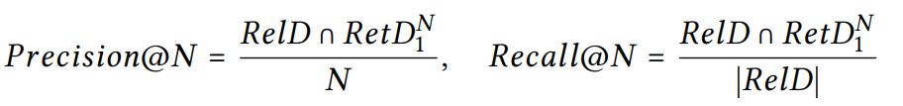
Evaluation
Evaluation is based on the NDCG (normalised discounted cumulative gain) metric.
The precision and recall is given by:
Notes:
nDCG: Normalised Discounted Cumulative Gain
IDCG: Ideal Discounted Cumulative Gain
DCG: Discounted Cumulative Gain
CG: Sum of relevance scores of the documents retrieved by the query
Q: No of queries.
N: No of positions = p
Precision = No .of elements in Intersection of Relevant Documents Set and Documents Retrieved by our system divided by the total number of documents in analysis.
Recall = No .of elements in Intersection of Relevant Documents Set and Documents Retrieved by our system divided by the no. of docs in Relevant Documents Set.

Slide 13
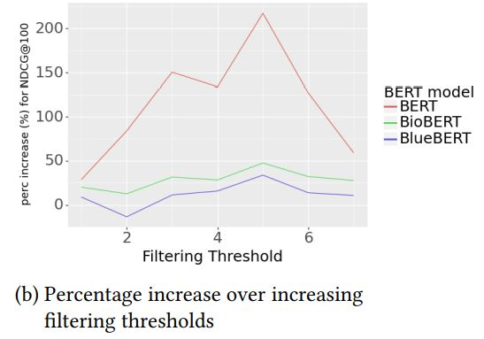
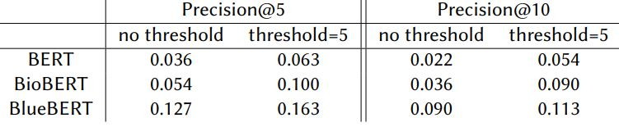
Results
Filtering Threshold = 5 consistently for
all models used
Notes:
Application of filtering with this threshold, NDCG performance improves consistently across models.
this observation underlines the potential of semantic enhancement across domains
BERT : trained on Wikipedia and BookCorpus
BioBERT: Pubmed papers
BlueBERT: trained in a multi-task setting on a combination of biomedical and clinical data
BioBERT and BlueBERT outperform BERT due to the expected overlap between the documents they was trained on and the scientific papers in the evaluation datasets
RIGHT PICTURE: Performance improvement for NDCG@100 over initial BERT models with the addition of SNOMED-based filtering. We can see the improvement (light blue) for the full dataset (left) and different subsets of the dataset (right) split based on the minimum number of ground truth documents for each query (GTD).
LEFT PICTURE: Precision comparison for different models between no threshold and the optimal threshold (5) version

Slide 14
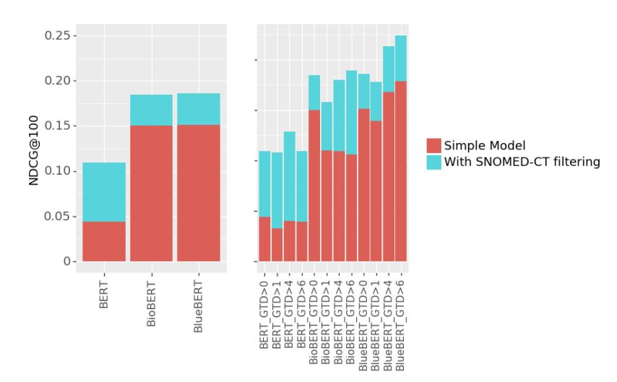
Notes:
Performance improvement for NDCG@100 over initial BERT models with the addition of SNOMED-based filtering.
We can see the improvement (light blue) for the full dataset (left) and different subsets of the dataset (right) split based
on the minimum number of ground truth documents for each query (GTD).
When GTD are less, we get less improvement. WHen GTD are more, we get maximum improvement.

Slide 15
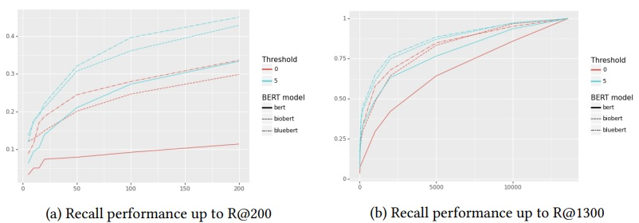
Notes:
the low number of related documents per query significantly impacts the Recall@N values shown in which start from low values for all model and threshold variations. However, we can see that still, comparing the baseline BERT models when there is no concept-based filtering and the case where we use the previously identified optimal threshold for filtering (𝑡ℎ𝑟𝑒𝑠ℎ𝑜𝑙𝑑 = 5), we get a significant improvement for recall, with emphasis on 𝑁 < 200.

Slide 16
Conclusion
The use of SNOMED-CT with BERT model variations showed that even with a simple co-occurrence filtering method,they can significantly improve the ranking results.
They show that for multi-document queries given on BlueBERT model as a basis, the filtering method gives 0.23 value for the NDCG@100 metric. They can also get meaningful gains across different metrics even for models trained on generic data.
Above outcomes provide basis for further experimentation into better exploitation of knowledge graphs and concept hierarchies as a means of boosting IR on new topics in an unsupervised manner.
They further establish their findings by applying the described approach to the full OHSUMED corpus, as well as other biomedical datasets (CLEF, TREC CDS, TREC CORD-19, etc).
They intend to experiment with neural network architectures other than BERT, such as XLNET and ELECTRA.

Slide 17
Future work
They will explore in more details the potential of the SNOMED-CT hierarchy because in this work They only incorporated the description and first parent node of each identified concept, without further traversing the concept graph.
They hypothesis that the position of a concept in the hierarchy as well as the neighbourhood size will impact the size of intersecting concepts between queries and documents (hence impacting the threshold value which can allows us to see links between missed documents.
The incorporation of different types of neighbours for each concept would allow us to come up with more elaborate re-ranking formulas, taking into account multiple variables to produce the final document score.
The use of external knowledge sources such as SNOMED-CT not in order to obtain a re-ranking functionality, but as a means to achieve transfer learning and distant supervision to better adapt deep neural networks and pretrained embeddings to new domains.

Slide 18
Thank You.

